Slide 1
IBM Business Automation Workflow clients improve you processes
with
IBM Process Mining
Patrick Megard - patrick.megard@fr.ibm.com

Slide 2

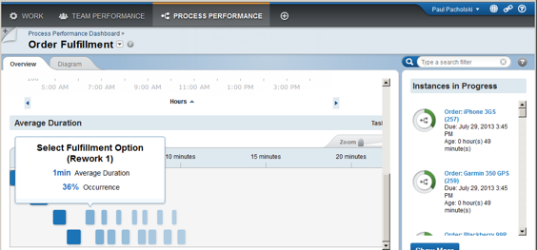
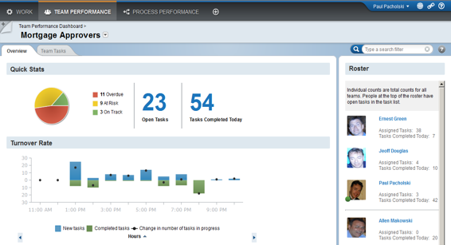
Do you have enough visibility on your existing BAW process performance?
Process and team performance dashboards in BAW are good but:
Adding new business-related dashboards requires programming
BAI is a valuable solution but:
What if it is not adopted?

Slide 3

What if you could easily get much more insights to improve your processes?
Where are the bottlenecks?
What is the root-cause of late payments?
What is the ROI if I change the BPM model and add a RPA bot?
Which loan applications require most reworks?
How can I act upon detection of issues?

Slide 4
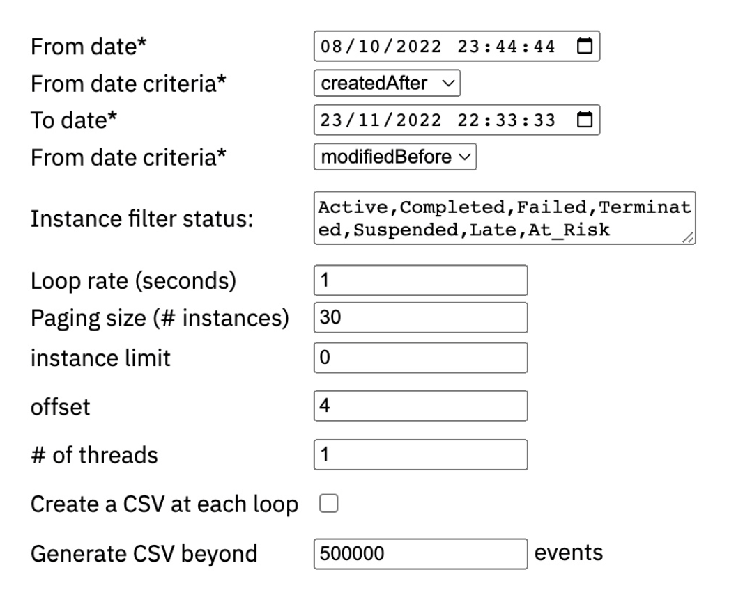
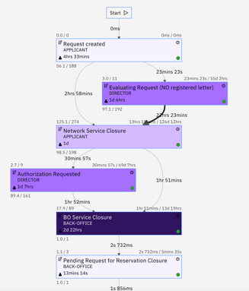
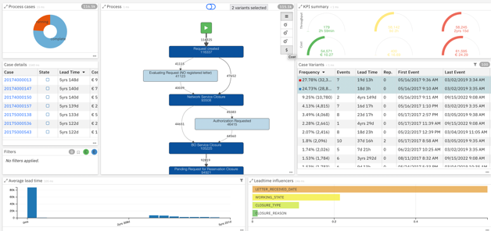
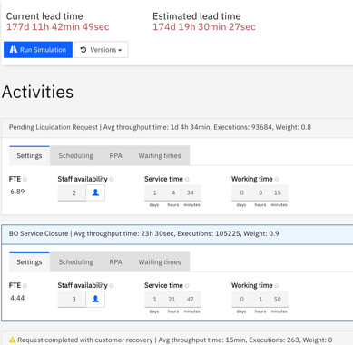
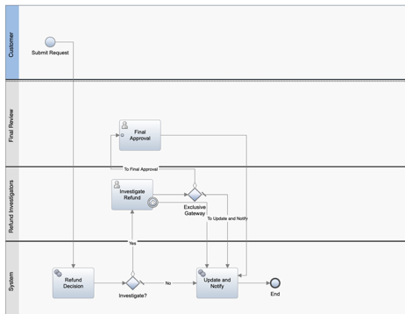
BAW Accelerator for IBM Process Mining enables:
Few clicks to connect BAW and IPM with REST APIs
Analyze process variants, durations, deviations, costs, bottlenecks
Create and share business dashboards
Simulate improvements and get ROI
Monitor business KPIs
Improve processes
BAW Accelerator 4 IPM
IBM Business Automation Workflow
IBM Process Mining

Slide 5

Spanish Real Estate - Ticketing
Case study: Ticketing
Process mining was used as a dashboarding capability to increase visibility on the ticketing process automated with IBM Business Automation Workflow.
Challenges:
Improve internal efficiency and ticket resolution time
Increase visibility on the automated process
Results:
1d
Potential improvement in process leadtime
20K
2 weeks
55%
Process lead time reduction resolving tickets re-classification
Instances analyzed
Analysis

Slide 6
Demo

Slide 7
Notes
Historical data can be purged in BAW, but this is OK for a POC.
Cautious with impact on BAW performance. Extraction can take hours, use paging to reduce impact
After the POC, for production, it is likely that we fetch the data from the client audit log database.

Slide 8
Details: Historical extraction parameters
Manage the performance and the impact on BAW server
Extract instances/tasks for a period of time (from date1 to date2), with filtering options like created, modified, closed
Extract instances/tasks for a period of time with paging (ex 1000 instances each loop)
Extract instances with certain status (ex: Active, Completed, …)
Select task status (completed, active, …)
Parallelism (ex thread_count = 10)
date1
date2
date1
1000 instances
date2
 | 1 thread | 10 threads
308 instances/383 tasks | 7 min 44 | 46 s

Slide 9
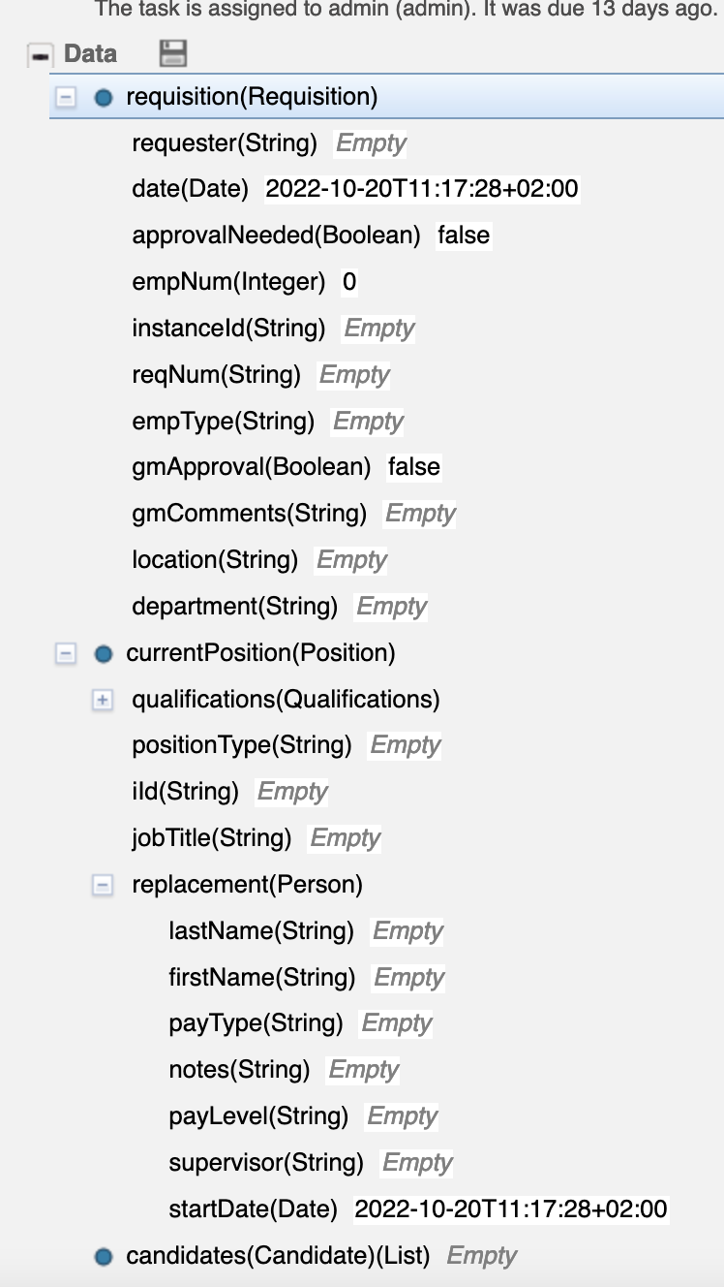
Details: BAW business data
Tracked variables (process level)
Can be automatically added to each event
Other process/task variables
Specified as a path ex: requisition.requester
Any business data can be extracted as contextual data. See: BAW/ProcessInspector/

Slide 10
Show the value with the client’s data: POC time!
Project scope
Data Preparation
Process Mining Analysis
Project Set-up
Objectives definition
Access configuration
Process Model
Data extraction
Data verification
Data load and mapping
Analysis
Performance Analysis
Dashboarding
Simulation and What-if scenarios
Alerting system
1 day
1 – 2 days
5 – 7 days

Slide 11

Conclusion
Extractor available at:
https://github.com/IBM/ibm-process-mining-BAW-accelerator
Contact: patrick.megard@fr.ibm.com

